Slide 1
St. Louis Plant Site Contamination

Slide 2
Plant Site Origin
The plant site was built in 1935 and was owned by the Michigan Chemical Corporation.
In the 1960s it switched hands to Velsicol Chemical Company.
Shortly after the switch the production of DDT was stopped.

Slide 3
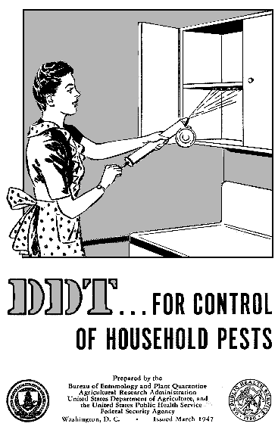
What’s DDT?
DDT is s chemical that was used as an insectide.
Its production was stopped because of the growing concerns over its toxic nature to other creatures and its ineffectiveness at killing insects.

Slide 4
Velsicol Chemical Company
The company started producing a fire retardant called Firemaster.
Firemaster contained PBB
PBB was not to be consumed by anyone
The company also produced a supplemental cattle feed.
In 1973 there was a mix up of the cattle feed and the fire retardant due to the packaging.

Slide 5
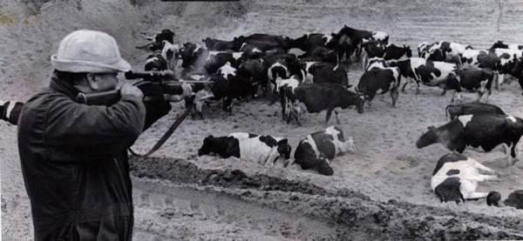
Effects of this mix up?
Hundreds of cattle were slaughtered due to their ingestion of PBB
It was then determined that everyone in the shipping area had ingested PBB
The long term effects of PBB are unknown.

Slide 6
Plant Site Contamination
It was then discovered by the DNR that the plant site was contaminated.
The DNR then made it practically impossible for Velsicol to keep producing.
The plant closed in 1978.
This caused the loss of over 300 jobs and drastically hurt the local economy.

Slide 7
Long term effects of the Contaimination
The contamination from the plant site affected many things, the town’s economy dropped, and the river next to it became practically useless.
The plant site’s contamination lead to the U.S Environmental Agency stepping in.
The goal was to get rid of the contamination and have the plant site land be useable again.

Slide 8
The contamination also caused concerns for how…
the clean up would be funded
what would be done to clean up the plant site and town
what efforts had been made to clean up to date
the EPA’s involvement and the citizens feelings on how things were and are being handled.

Slide 9
Slurry Wall
A slurry wall was built. Its purpose was to contain the contamination.
In 2006 studies showed that the slurry wall was failing to keep the contamination contained
In 2002 the slurry wall was suspected to be leaking but nothing was done about it.

Slide 10
The EPA
“The EPA discovered that the City of St. Louis’ public drinking water was contaminated by pCBSA in 2004. The EPA failed to share this information with the City of St. Louis or the Michigan Department of Environmental Quality for one year”- Diane D. Borello

Slide 11
Bibliography
Borello, Dianne D., “RE: Comments on the 5 Year Review of the Velsicol Chemical Superfund Site, St. Louis, Michigan, 4/14/13, http://pinerivercag.org/documents/?download=O+-+Site+Closeout%2FO2+-+Five+Year+Review%28s%29%2FFive+Year+Review+2007+-+Plant+Site%2FO-2+++Keon+++1_20110209104534.pdf.
Andromalos, Kenneth B. and Fisher, Michael J.,“Design and Control of Slurry Wall Backfill Mixes for Groundwater Containment”, 4/15/13, http://www.containment.fsu.edu/cd/content/pdf/041.pdf .

Slide 12
Bibliography Contd.
“History By Decades”, St. Louis Michigan Website, 4/8/13. http://www.stlouismi.com/1/stlouis/history_by_decades.asp.

