Slide 1
The Pine River

Slide 2
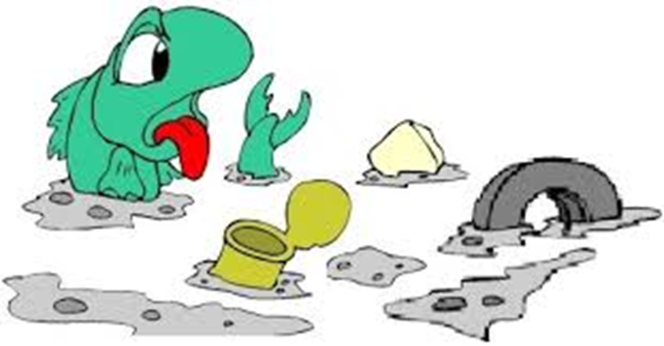
The Pine River is very Contaminated
After over 40 years of producing chemicals and dumping waste the site of the plant and the river were incredibly toxic.
High levels of DDT, 32,000 parts per million, were measured in the Pine River in 1996.
The Cleanup Standard is 5 parts per million.

Slide 3
Velsicol Was Not Held Accountable
After a consent judgment in 1982 Velsicol was only expected to build a slurry wall around the plant site, cover the site with clay and maintain the water levels within the containment system.
The company was essentially given a free pass on cleaning the river and all other aspects of the cleanup of the town of St. Louis.

Slide 4
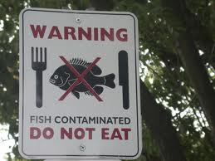
No Fish Consumption Advisory
The river sediment pollution was addressed in 1982 by the State of Michigan, which issued a no-consumption advisory for all species of fish in the Pine River.
The fish advisory remains in effect today

Slide 5
River Cleanup Cost
The newest cleanup operation costs $373 million.
That doesn’t even take into account the $100 million dollars that was paid for the cleanup from 1999-2006 when they were trying to clean up the river sediment.
Those are two very expensive projects that Velsicol had to contribute little to no money to.

Slide 6
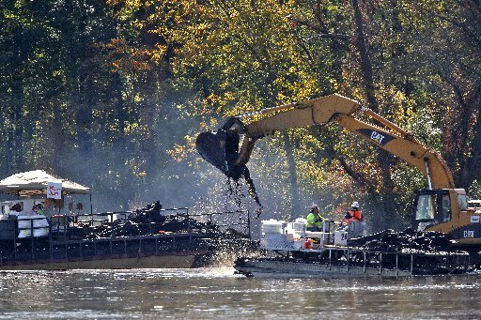
River Cleanup Techniques
Cofferdams were installed.
After the cofferdams were up a dewatering of the areas began.
After the dewatering they excavated the contaminated sediment and a stabilization of the sediments with a drying agent was done.
There was also a treatment of the water removed from the excavation areas.
All of the old contaminated sediment was shipped off to an offsite dumpsite

Slide 7
Dense Non-Aqueous Phase Liquid
The issue of Dense Non-Aqueous Phase Liquid was discovered during sediment cleanup, which was in part created by all of the chemical production that occurred for forty years.
It is a toxic sludge of sorts.
It can migrate through soil and waterways and became an issue because it was carrying all of the toxins from the plant site because the slurry wall was failing.
It also can carry chunks of PBB to the river bottoms where the fish can ingest them.

Slide 8
New Technique Needed
Due to the DNAPL from the plant site a new technique was needed to contain the toxins.
They had to build an interceptor trench along the riverbank to collect DNAPL migrating from the plant site.
They also had to pump DNAPL from the river bottom.

Slide 9
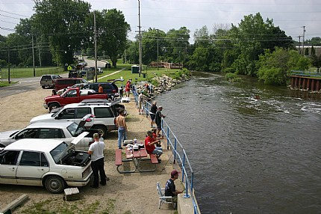
A Town Tries to Heal
St. Louis is a town that is still trying to recover from the devastation caused by the Velsicol company. As the cleanup continues St. Louis slowly sheds their image as a toxic town.
But although they have been through so much their spirit remains. A sign of this can be seen by the Joe Scholtz Annual Free Fishing Derby which is going on its 15th year in 2013. Even though they can’t eat the fish they still get rewarded for biggest catch!

Slide 10
Bibliography
Environmental Protection Agency, February, 2012, http://www.epa.gov/region5/superfund/npl/michigan/MID000722439.html
Linda Gittleman, Morning Sun, January 20, 2013, http://www.themorningsun.com/article/20130120/NEWS01/130129995/st-louis-residential-cleanup-continues-plant-site-work-to-begin-in-the-summer#full_story
Robin Erb, Detroit Free Press, September 24, 2012, http://www.freep.com/article/20120924/NEWS01/309240082

