Slide 1
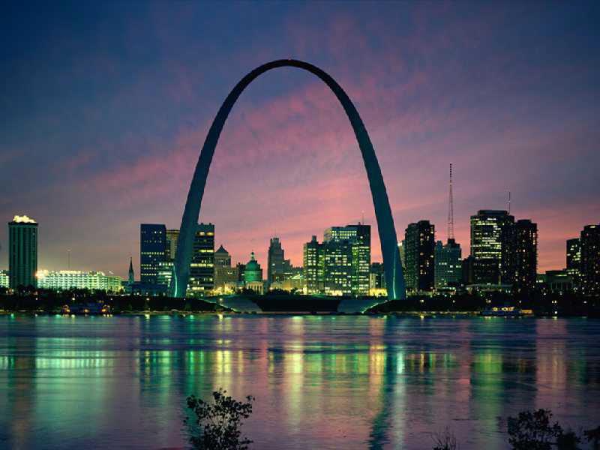
St. Louis
Motto: Gateway of the West
Population: 318,172

Slide 2
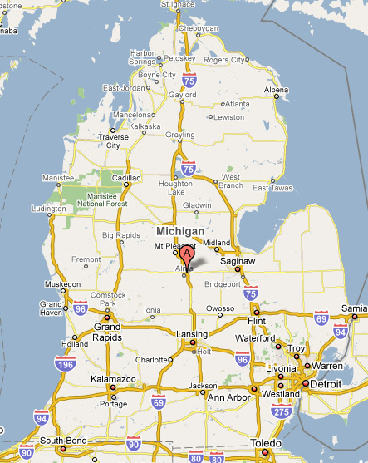
St. Louis, Michigan
Motto: Middle of the Mitten
Population: 7,482

Slide 3
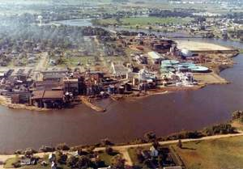
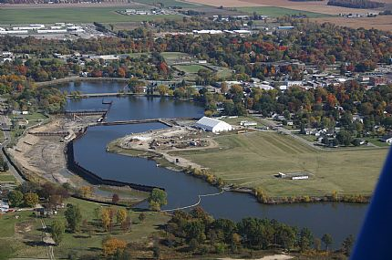
Velsicol Chemical Corporation
1970’s
Present Day

Slide 4
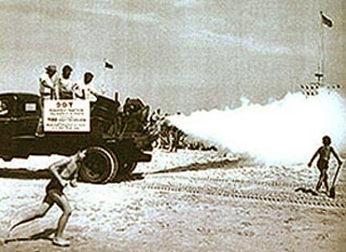
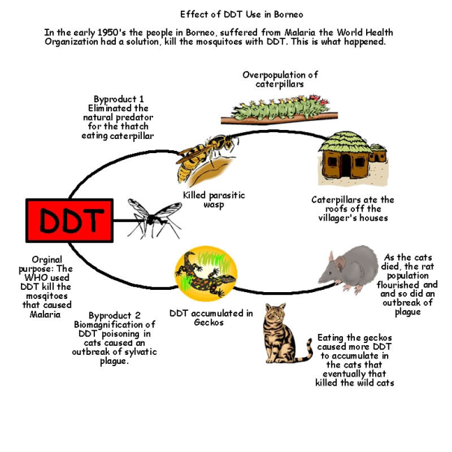
What did the plant produce?
PBB
DDT
Polybrominated biphenyls. Used to form a flame retardent. Not to be consumed by human being or beasts.
Dichlorodiphenyltrichloroethane. Used to remove pesticides from large areas.

Slide 5
How did the plant effect?
How did the chemicals the plant produce effect the surrounding environment?
How did the chemicals the plant produce effect the community?
How did the chemicals the plant produced effect the animals that live throughout the environment?
Why does this matter to me?
http://www.youtube.com/watch?v=B3bMetQmmbE

