Slide 1
Chemicals in the Pine: The Contaminated story of St. Louis, Michigan
Jeri Glomstead, Angela Blevins, and
Jeff Malinowski

Slide 2
Michigan Chemical Company
Formed in 1935
Manufactured DDT during the 1930s and 1940s
    More on that later
Bought out in 1960

Slide 3

Velsicol Chemical Company
Bought Michigan Chemical Company in the 1960s
1973 mix up of fire suppressant (containing PBB) and cattle feed
News of chemical mix-up caused DNR to fine Velsicol, and the St. Louis plant was closed
Plant site was capped with clay, and everything was wrapped up... or so they though

Slide 4
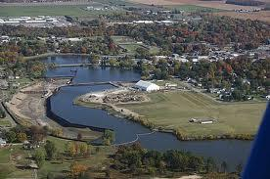
Contamination in the Pine River
1994, Pine River was detected as being contaminated with DDT
The US EPA investigated, and discovered that the contamination was widespread and a serious risk to the community

Slide 5
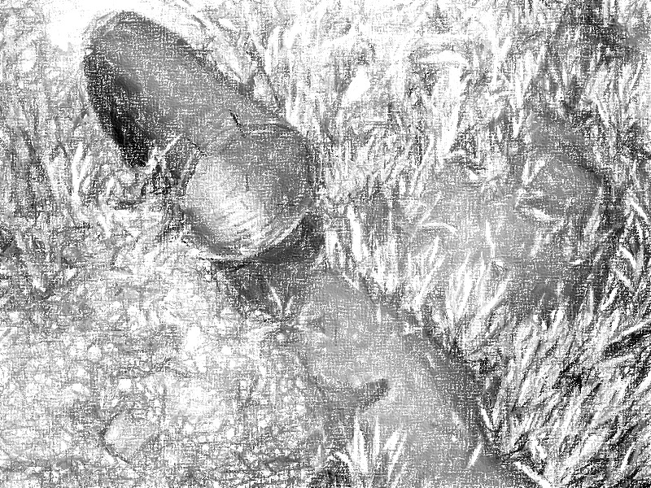
Clean up
The discovery of the contamination on Velsicol Chemical Company property and the discovery of the Pine River contamination forced the city to take action make St. Louis contamination free again.

Slide 6
Environmental Protection Agency
The EPA worked closely with St. Louis to help guide and fund the clean up.
In 1982, the EPA made a deal with Velsicol to relieve them of responsibility for further damages.
Together, the DNR and EPA dismantled Velsicol, carrying out contaminated pieces to be buried.

Slide 7
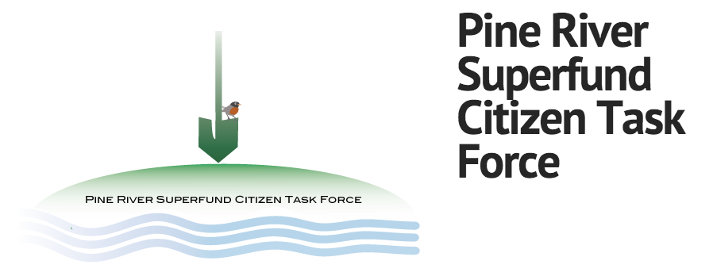
Pine River Superfund Citizens Task Force
Established in December, 1997, as a local branch of the EPA.
Their goal was to clean up Pine River and keep it clean and safe for St. Louis citizens

Slide 8
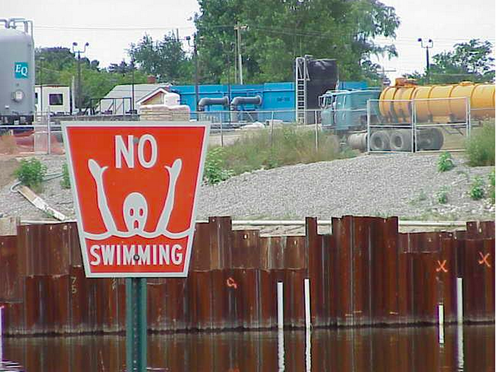
Pine River Superfund Citizens Task Force
In 1999, the task force was granted $50,000 from the EPA to assist in the Pine River clean up
The task force is actively working to keep the river safe by having monthly meetings with citizens & environmental officials

Slide 9
Water and Wastewater Department
The St. Louis Water and Wastewater Department played an important role on the safety of the drinking water in St. Louis
Their main priority after the contamination is making sure the city has clean drinking water to its citizens
The Water and Wastewater Department helped ensure clean drinking water by filing a lawsuit against Velsicol to pay for the damages to the wells and ensure future clean water

Slide 10
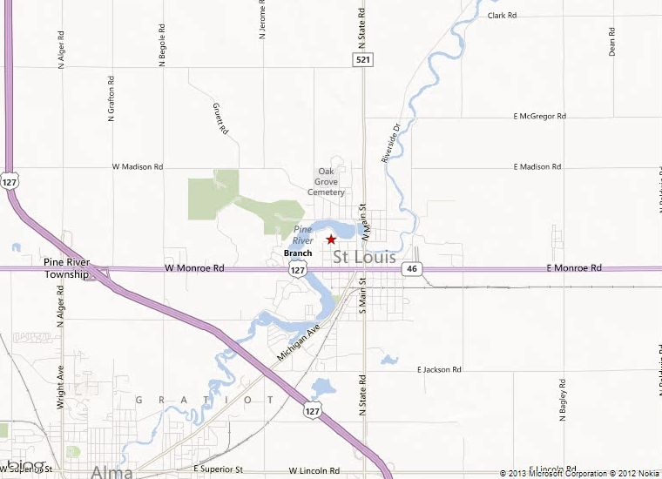
Vesicol Chemical Corp Superfund Site
-53 Acers-

Slide 11
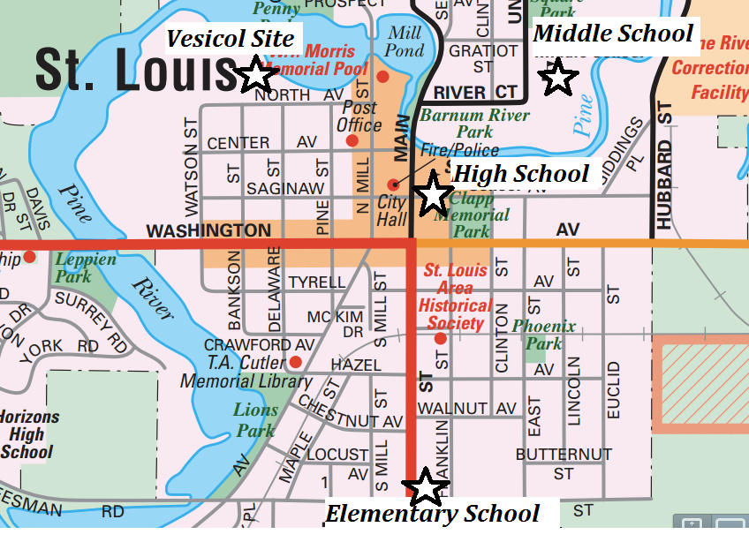
Public School Locations
113 E Saginaw St, St Louis, MI 48880
  High School
301 W State St, St Louis, MI 48880
  Nikkari Elementary School
312 Union St, St Louis, MI 48880
  TSN Middle School

Slide 12
Recreation Area Diagram, illustrating the site’s connection with area schools and recreation facilities

Slide 13
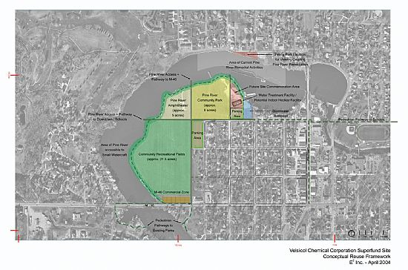
Composite Land Use Map: The Chemical Corporation Superfund Site and the City of St. Louis

Slide 14
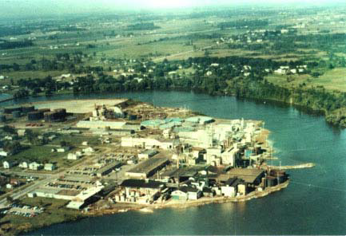
Birds Eye Photograph of Superfund Site (1970)
Aerial Photograph of the Velsicol Chemical Corp. Site (1975)
Birds Eye Photograph of the Vesicol Chemical Corp. Superfund Site (1990s)
Aerial Photograph of the Vesicol Chemical Corp. Superfund Site (2002)

Slide 15
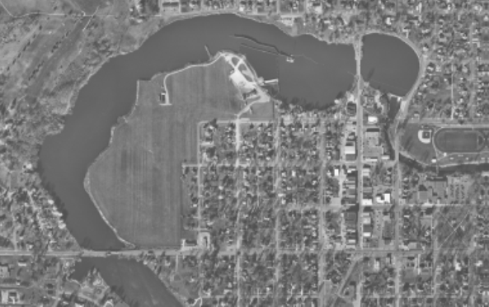
1975 Areal Photograph of Vesicol Compared to 2002 Photograph
1975
2002

Slide 16
Bibliography
"MapQuest Maps - Map." MapQuest Maps - Driving Directions - Map. http://www.mapquest.com (accessed April 27, 2013).
"Rescue Planning Report for Velsicol Chemical Corporation Superfund Site." Recognising the Past Looking into the Future. www.stlouismi.com/1/stlouis/files/VelsicolReportFinalJuly2004.pdf (accessed April 23, 2013).
"Velsicol Chemical Corp. (Michigan) | Region 5 Cleanup Sites | US EPA." US Environmental Protection Agency. http://www.epa.gov/region5/cleanup/velsicolmichigan/ (accessed April 23, 2013).
McMacken, David, History by Decades. 2005-2013. http://www.stlouismi.com/1/stlouis/history_by_decades.asp (Accessed April 8, 2013).
Author Unknown, Pine River Superfund Citizen Task Force, 2010 http://pinerivercag.org/node/3
(Accessed April 23, 2013)

